Slide 1
ALY 6070 Communication and Visualization for Data Analytics
Choosing an Effective Visual

Slide 2
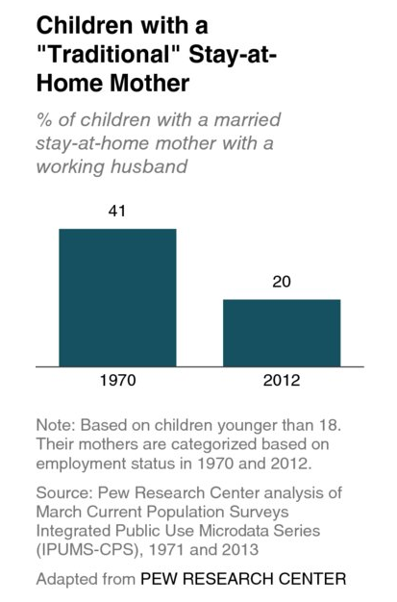
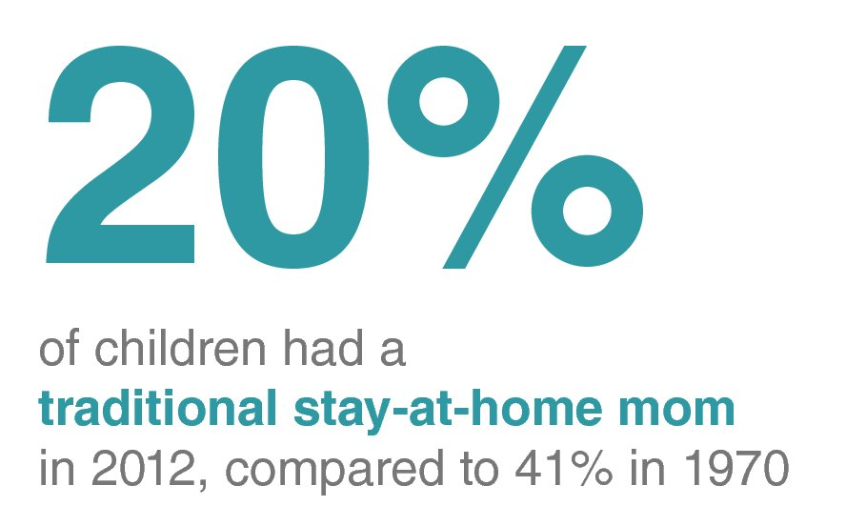
Simple text
When you have just a number or two to share, simple text can be a great way to communicate
When you have just a number or two that you want to communicate: use the numbers directly.
Vs.
*source: https://www.safaribooksonline.com/library/view/storytelling-with-data/9781119002253/c02.xhtml

Slide 3
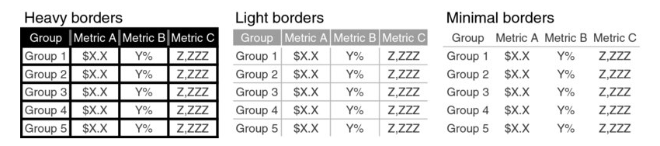
Tables
Tables interact with our verbal system, which means that we read them (higher cognitive load)
Minimize visual distractions (clutter)
*source: https://www.safaribooksonline.com/library/view/storytelling-with-data/9781119002253/c02.xhtml

Slide 4
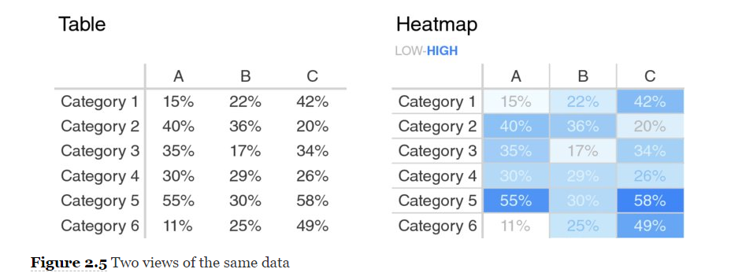
Heatmap
A heatmap is a way to visualize data in tabular format, where in place of (or in addition to) the numbers, you leverage colored cells that convey the relative magnitude of the numbers.
*source: https://www.safaribooksonline.com/library/view/storytelling-with-data/9781119002253/c02.xhtml

Slide 5
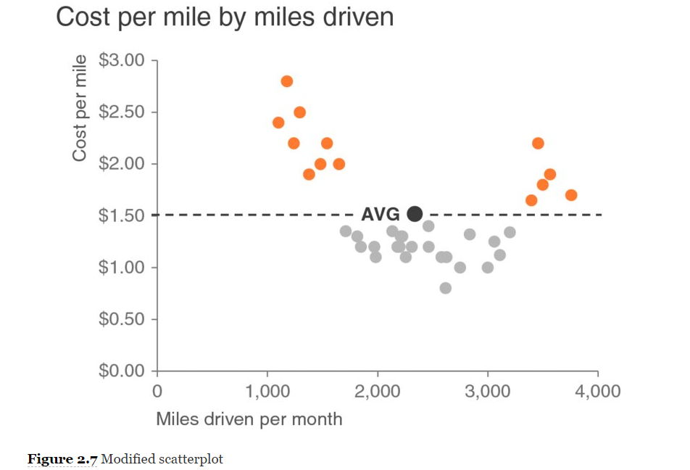
Scatterplot
Scatterplots can be useful for showing the relationship between two things, because they allow you to encode data simultaneously on a horizontal x-axis and vertical y-axis to see whether and what relationship exists
*source: https://www.safaribooksonline.com/library/view/storytelling-with-data/9781119002253/c02.xhtml

Slide 6
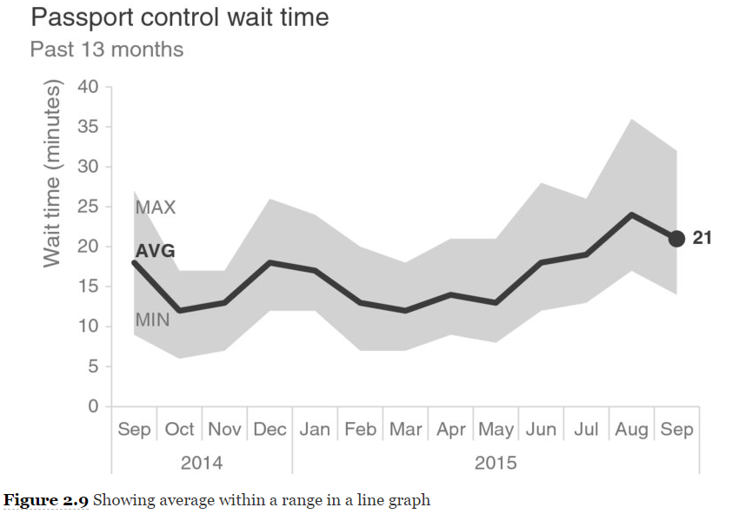
Lines
Line graphs are most commonly used to plot continuous data. Because the points are physically connected via the line, it implies a connection between the points that may not make sense for categorical data
Unit of time: days, months, quarters, or years.
*source: https://www.safaribooksonline.com/library/view/storytelling-with-data/9781119002253/c02.xhtml

Slide 7
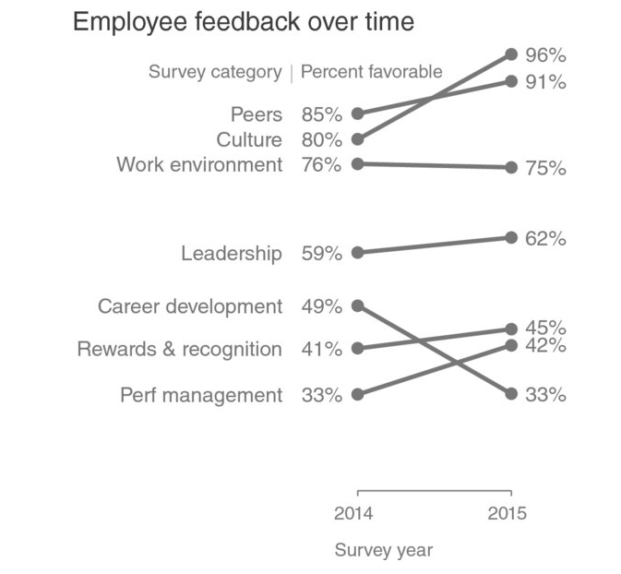
Slopegraph
Slopegraphs can be useful when you have two time periods or points of comparison and want to quickly show relative increases and decreases or differences across various categories between the two data points.
*source: https://www.safaribooksonline.com/library/view/storytelling-with-data/9781119002253/c02.xhtml

Slide 8
Bars
Bar charts should be leveraged because they are common
Low cognitive load for audience
Bar charts are easy for our eyes to read. Our eyes compare the end points of the bars, so it is easy to see quickly which category is the biggest, which is the smallest, and also the incremental difference between categories.
Note that, because of how our eyes compare the relative end points of the bars, it is important that bar charts always have a zero baseline (where the x-axis crosses the y-axis at zero), otherwise you get a false visual comparison.
*source: https://www.safaribooksonline.com/library/view/storytelling-with-data/9781119002253/c02.xhtml

Slide 9
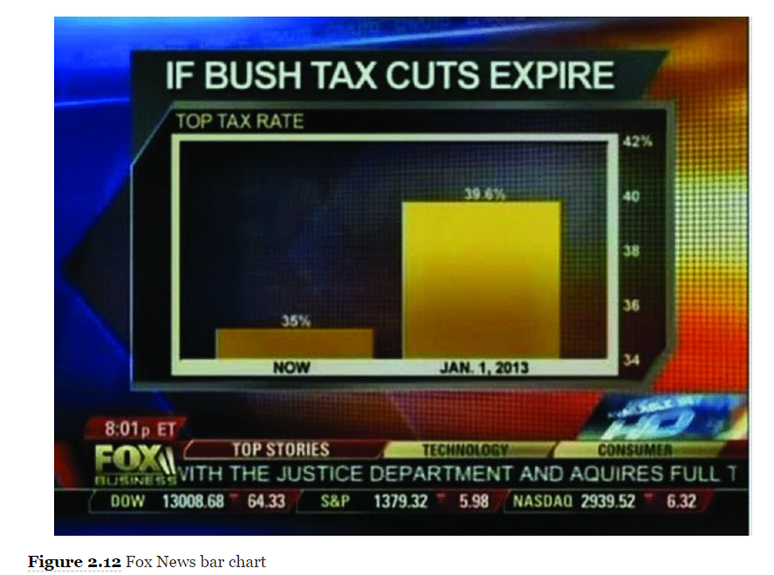
Bars
*source: https://www.safaribooksonline.com/library/view/storytelling-with-data/9781119002253/c02.xhtml

Slide 10
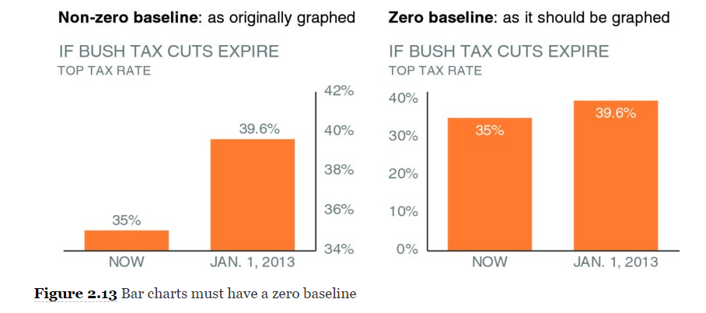
Bars
*source: https://www.safaribooksonline.com/library/view/storytelling-with-data/9781119002253/c02.xhtml

Slide 11
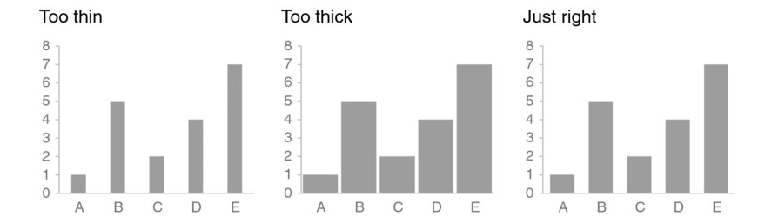
Vertical Bar Chart
Single series, two series, or multiple series.
Note that as you add more series of data, it becomes more difficult to focus on one at a time and pull out insight, so use multiple series bar charts with caution
*source: https://www.safaribooksonline.com/library/view/storytelling-with-data/9781119002253/c02.xhtml

Slide 12
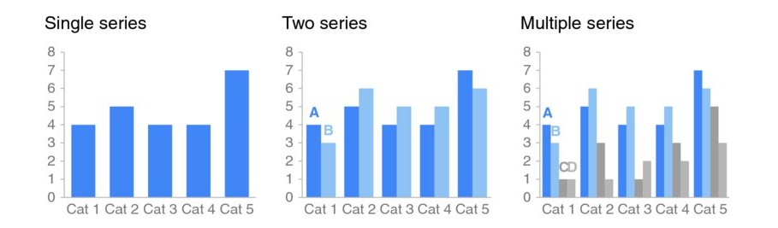
Vertical Bar Chart
*source: https://www.safaribooksonline.com/library/view/storytelling-with-data/9781119002253/c02.xhtml

Slide 13
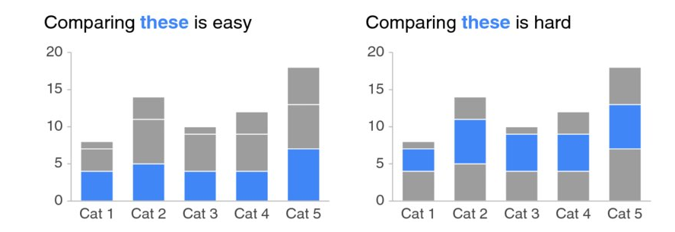
Vertical Bar Chart – Stacked Series
*source: https://www.safaribooksonline.com/library/view/storytelling-with-data/9781119002253/c02.xhtml

Slide 14
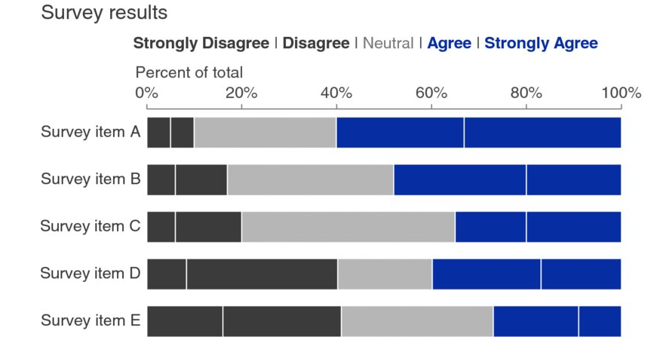
Stacked Horizontal Bar Chart
Used to show the totals across different categories but also give a sense of the subcomponent pieces. They can be structured to show either absolute values or sum to 100%
*source: https://www.safaribooksonline.com/library/view/storytelling-with-data/9781119002253/c02.xhtml

Slide 15
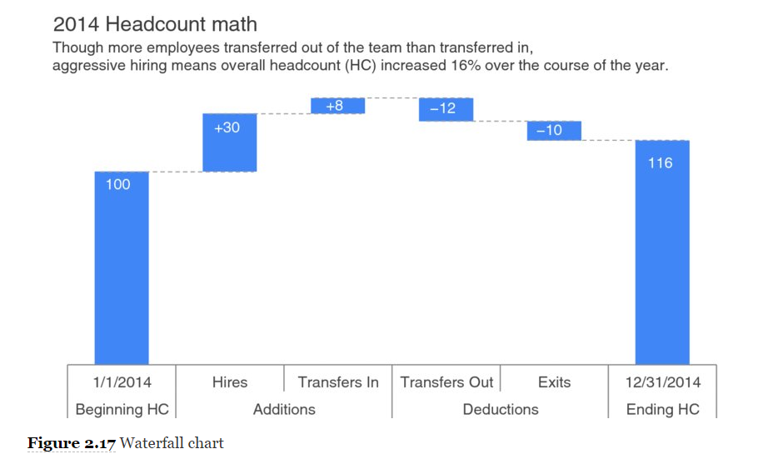
Waterfall chart
The waterfall chart can be used to pull apart the pieces of a stacked bar chart to focus on one at a time, or to show a starting point, increases and decreases, and the resulting ending point.
*source: https://www.safaribooksonline.com/library/view/storytelling-with-data/9781119002253/c02.xhtml

Slide 16
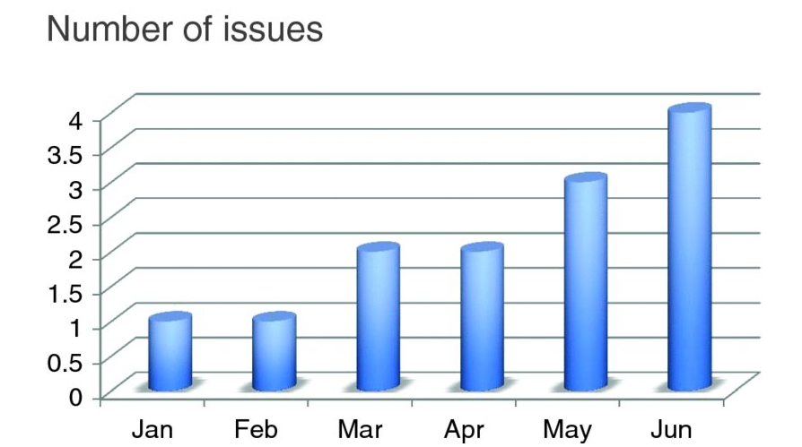
3D have really high Cognitive Load
How many issues are there in Jan and Feb? Mar and Apr?
*source: https://www.safaribooksonline.com/library/view/storytelling-with-data/9781119002253/c02.xhtml

Slide 17
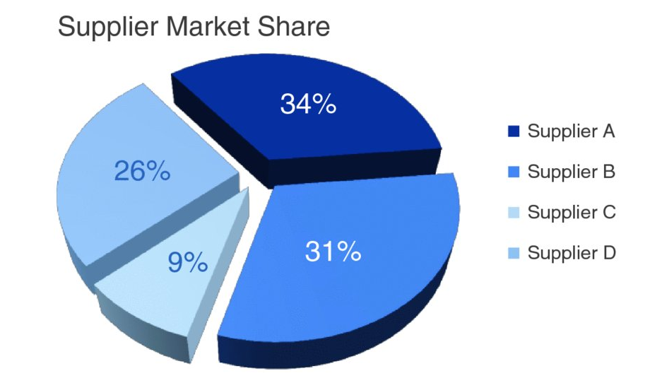
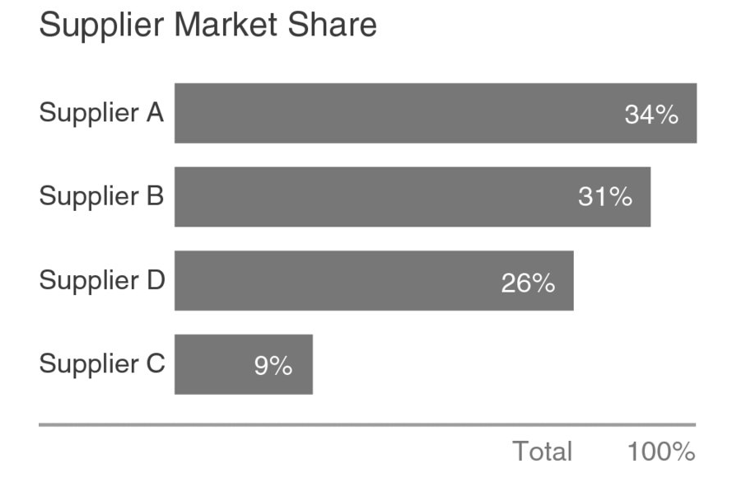
Use Pie Charts with caution
Vs.
In which visual above is it easier and quicker to see that Supplier A is greater than Supplier B?
*source: https://www.safaribooksonline.com/library/view/storytelling-with-data/9781119002253/c02.xhtml

Slide 18
Closing thoughts
Always think back to the context
What types of graphs is the audience used to seeing?
Limit cognitive load, human brain judges visual distance much quick in a graph than in a table
No one right answer, many options exist but consider:
  Time series usually make more sense as line graphs
  Pie charts are sometimes helpful but can be distracting if two groups are similar in size
  Avoid too many colors, use them instead to draw attention
*source: https://www.safaribooksonline.com/library/view/storytelling-with-data/9781119002253/c02.xhtml

